Slide 1


S.A.P.D.J. Pathashala’s
Walchand Institute of Technology
An Autonomous Institute
A predictive model to assess the environmental impact of urban expansion
Pranita Annaldas
Ketaki Bidkar
Rumesha Khan
Samruddhi Chobharkar
Padamaja Alase
Vaishnavi Birajdar

Slide 2
Content
Idea of the project
Background of Project
Methodology
Software required
Technology Stack
Testing
Work Distribution
References

Slide 3
Idea of the project:
Current Scenario:
Rapid urbanization is straining natural resources, leading to issues like air pollution, traffic congestion, flooding, etc.
The city lacks effective tools for managing resource demands, resulting in ecological imbalance.
Need:
Accurate predictive models are needed to predict resource demands and mitigate environmental risks .
Sustainable planning is essential to prevent further environmental degradation.
Motivation:
Addressing urban overpopulation.
Optimizing resource allocation.
Environmental protection.
Advancing urban planning.

Slide 4
Background of Project :
S.No | Name Of Paper | Published In | Summary
1. | Toward more comprehensive environmental impact assessments: interlinked global models of LCIA and IAM applicable to this century. | 2020, The International Journal of Life Cycle Assessment | Research investigates the application of the lifecycle impact assessment method based on endpoint modeling (LIME), which is developed to be consistent with integrated assessment models (IAMs) that include resource balance models and a simplified climate model (Tokimatsu et al., 2020).
2. | Data-driven predictive modeling of PM2.5 concentrations using machine learning and deep learning techniques: a case study of Delhi, India. | 2022, Environmental Monitoring and Assessment (Springer) | The study titled "Assessing the Potential of AI-ML in Urban Climate Change Adaptation and Sustainable Development" explores the role of artificial intelligence and machine learning (AI-ML) in addressing climate change adaptation within urban contexts(Masood and Ahmad, 2022).

Slide 5
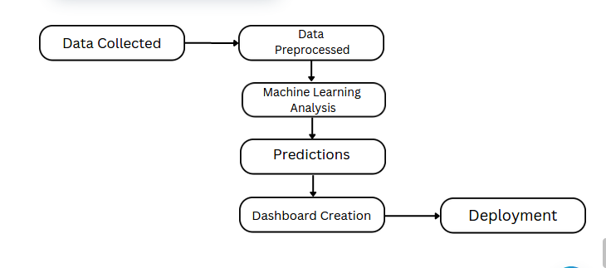
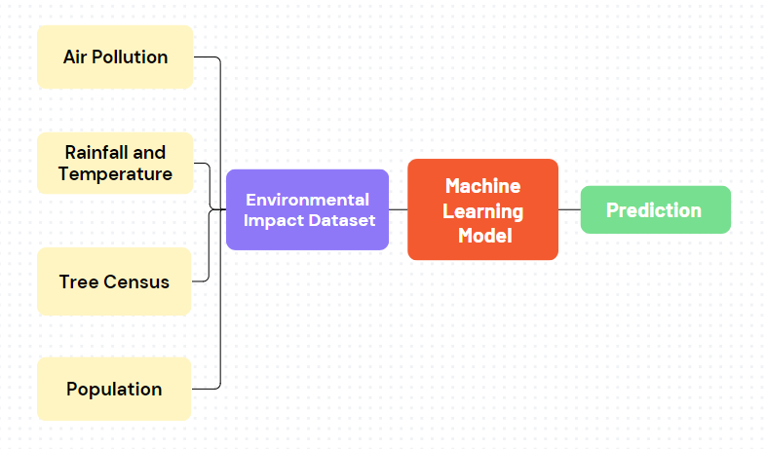






Methodology :

Slide 6

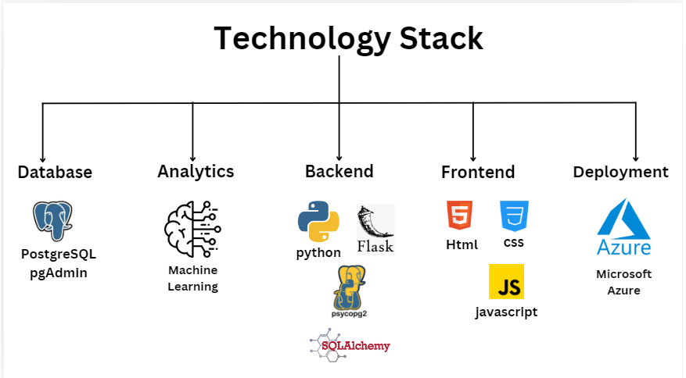
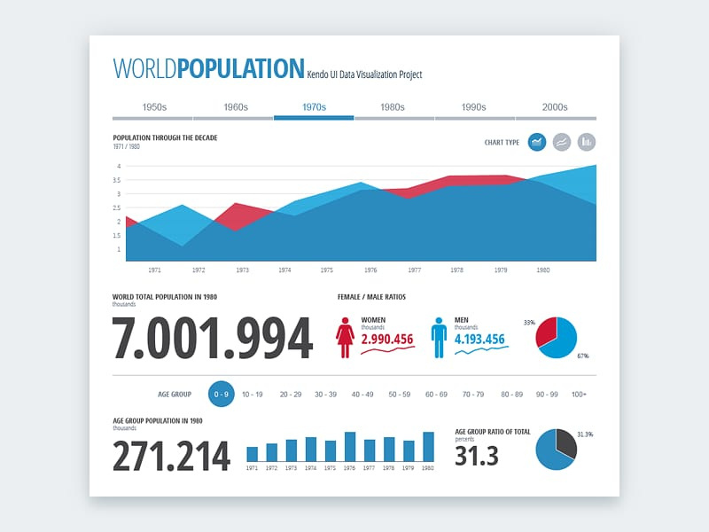

Software Required: :
TensorFlow
PyTorch
scikit-learn
Pandas
Numpy
Flask
API
Testing :

Slide 7
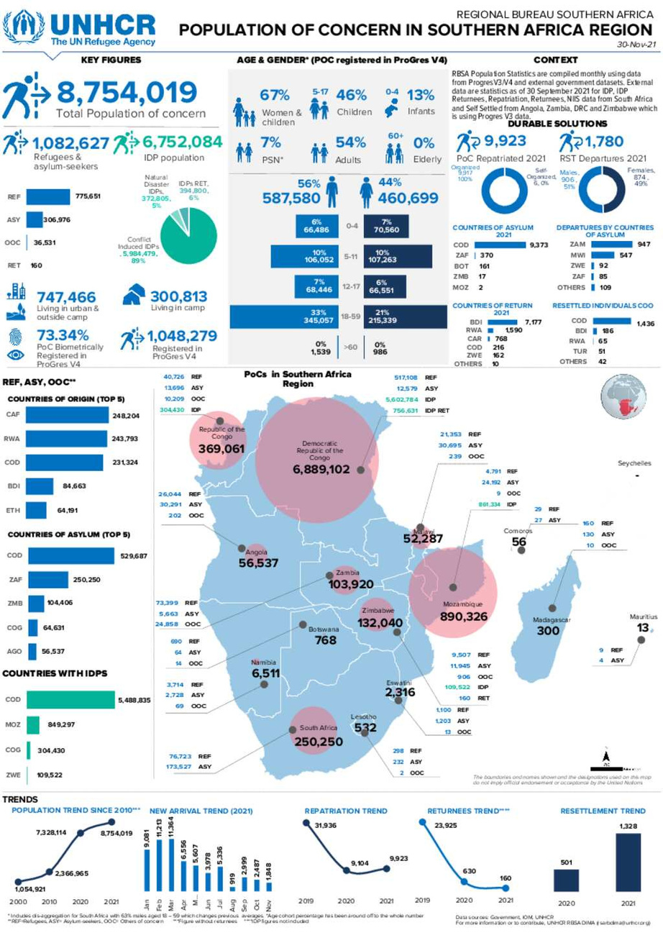


Work Distribution :
Pranita :
Data Preprocessing, Machine Learning Analysis.
Ketaki :
Data Preprocesssing, Machine Learning Analysis.
Rumesha :
Frontend Development, Deployment.
Samruddhi :
Backend Development, Database Management.
Padamaja :
Frontend Development, Deployment.
Vaishnavi :
Frontend Development, Deployment.

Slide 8
References :
Roy, A.B., Garai, N. and Jayanta Kumar Biswas (2023). Exploration of urban sustainability in India through the lens of sustainable development goals. Discover Sustainability, 4(1). doi: https://doi.org/10.1007/s43621-023-00158-2.
Xian, S., Li, L. and Qi, Z. (2019). Toward a sustainable urban expansion: A case study of Zhuhai, China. Journal of Cleaner Production, 230, pp.276–285. https://doi.org/10.1016/j.jclepro.2019.05.087.
Masood, A. and Ahmad, K. (2022). Data-driven predictive modeling of PM2.5 concentrations using machine learning and deep learning techniques: a case study of Delhi, India. Environmental Monitoring and Assessment, 195(1). doi: https://doi.org/10.1007/s10661-022-10603-w.
Masood, A. and Ahmad, K. (2022). Data-driven predictive modeling of PM2.5 concentrations using machine learning and deep learning techniques: a case study of Delhi, India. Environmental Monitoring and Assessment, 195(1). doi: https://doi.org/10.1007/s10661-022-10603-w.
Srivastava, A. and Maity, R. (2023). Assessing the Potential of AI–ML in Urban Climate Change Adaptation and Sustainable Development. Sustainability, [online] 15(23), p.16461. doi: https://doi.org/10.3390/su152316461.
Marzouk, M. and Shimaa Azab (2024). Modeling climate change adaptation for sustainable coastal zones using GIS and AHP. Environmental monitoring and assessment, 196(2). doi: https://doi.org/10.1007/s10661-023-12287-2.
https://data.opencity.in/dataset?organization=pune-municipal-corporation
http://opendata.punecorporation.org/Citizen/CitizenDatasets/Index
https://www.indiastatdistricts.com/maharashtra/pune/meteorologicaldata/annualrainfall/data-year/2012

Slide 9

Question and Answe﻿r...
Thank you

